Slide 1
Content Development Process
Author Review Approve
Editorial
Team
Assigned
by
HFE
Content
Development
Team
Editorial
Team
Contributor

Slide 2
Content Development Process
Identify Plan Author Review Approve
Identify or generate candidate source material.
Map source material to location in content matrix to get into pipeline and prioritized.
Source material distilled into drafts of page content.
Page drafts edited according to style guidelines, conceptual framework, and voice.
Page drafts subject to technical approval process.
Content Development Team
Discovery Team
Other Contributor
Discovery Team
Editorial Team
Editorial Team
Editorial Team
Assigned by HFE

Slide 3
Content Development Process
Identify Plan Author Review Approve
Identify or generate candidate source material.
Map source material to location in content matrix to get into pipeline and prioritized.
Source material distilled into drafts of page content.
Page drafts edited according to style guidelines, conceptual framework, and voice.
Page drafts subject to technical approval process.
Content Development Team
Discovery Team
Editorial Team
Other Contributor
Discovery Team
Editorial Team
Editorial Team
Editorial Team
Assigned by HFE

Slide 4
Content Development Process
Identify Plan Author Review Approve
Identify or generate candidate source material.
Map source material to location in content matrix to get into pipeline and prioritized.
Source material distilled into drafts of page content.
Page drafts edited according to style guidelines, conceptual framework, and voice.
Page drafts subject to technical approval process.
Content Development Team
Discovery Team
Editorial Team
Other Contributor
Discovery Team
Editorial Team
Editorial Team
Editorial Team
Assigned by HFE

Slide 5
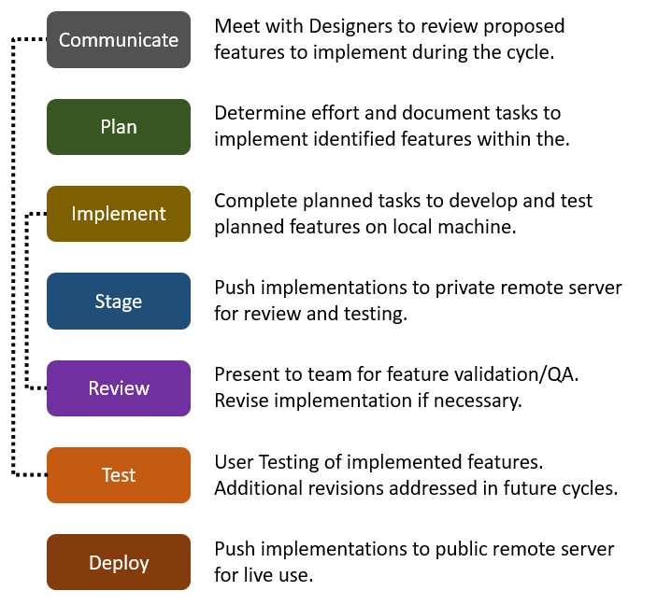
Design Process
User Testing
Annotate Designs
Design
Redesign
IA, wireframing, prototyping
End user feedback on content and prototype. Produce user stories to capture design implications.
Review user stories; prioritize; edit designs, content, and prototype.
Review and approve final.
Annotate designs for hand-off to Wordpress development.
Schedule meeting for development handoff.
Content Development Team
Discovery Team
Editorial Team
Other Contributor
User Testing Team
PM
Content Development Mgr
Editorial Team
Design Team
User Testing Team
Editorial Team
Design Team

Slide 6
Design Process
User Testing
Annotate Designs
Design
Redesign
IA, wireframing, prototyping
End user feedback on content and prototype.
Produce user stories to capture design implications.
Review user stories; prioritize; edit designs, content, and prototype.
Review and approve final.
Annotate designs for hand-off to Wordpress development.
Schedule meeting for development handoff.
Content Development Team
Discovery Team
Editorial Team
Other Contributor
User Testing Team
PM
Content Development Mgr
Editorial Team
Design Team
User Testing Team
Editorial Team
Design Team

Slide 7
Development Process
Communicate
Plan
Implement
Stage
Review
Test
Approve
Deploy
Meet to review proposed features to implement during the cycle.
Determine effort and document tasks to implement identified features within the cycle.
Meet to discuss scope and priorities.
Complete planned tasks to develop and test planned features on local machine.
Standup meetings 3 times per week.
Push implementations to private remote server for review and testing.
Present to team for feature validation/QA. Revise implementation if necessary.
User Testing of implemented features. Additional revisions addressed in future cycles.
HFE Approval to Deploy
Push implementations to public remote server for live use.
Development Team
Design Team
Editorial Team
Development Team
Design Team
Editorial Team
PM
Content Development Mgr
Development Team
Development Team
Development Team
Design Team
Editorial Team
User Testing Team
User Testing Team
PM
Content Development Mgr
PjM
Development Team

